Slide 1


Florida FOOD policy council
July 30, 2021
Notes:
PDD21-0084 N121-0259 Slide 1 of 14 Mary Duke

Slide 2

FOOD POLICY ADVISORY COUNCIL
  Why Organize a Local Food Policy Advisory Council?
    A strong local food system supports small farms and independent grocery store owners, creating steady local jobs and driving economic growth as capital stays within the city (County).
    People who eat fresh, nutritious food have less need for costly health care and related government and community programs.
    A small, decentralized food system is less vulnerable to disruptions in the supply chain or lapses in quality control. http://172.23.17.11/bminquiry/default.aspx
    The average grocery store item in the United States travels 1,500 miles between production and consumption – local agriculture eliminates the costs of, and demand for, the energy resources needed for transportation and preservation, along with the related pollution.
    People who are self sufficient producers have more food security and more disposable income to spend at local businesses.
    Multi-family gardens encourage individuals to share resources with neighbors for the benefit of the community – creating cohesion, cooperation and a sense of place.
Notes:
There were many reasons Pasco County decided to form a Food Policy Advisory Council. Primarily to ensure residents had access to fresh local produce.

Slide 3
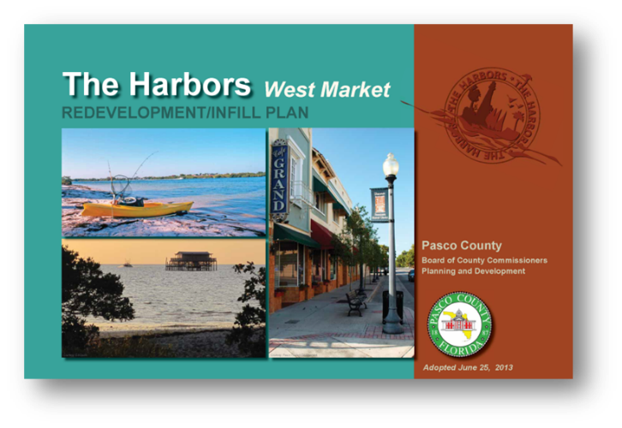
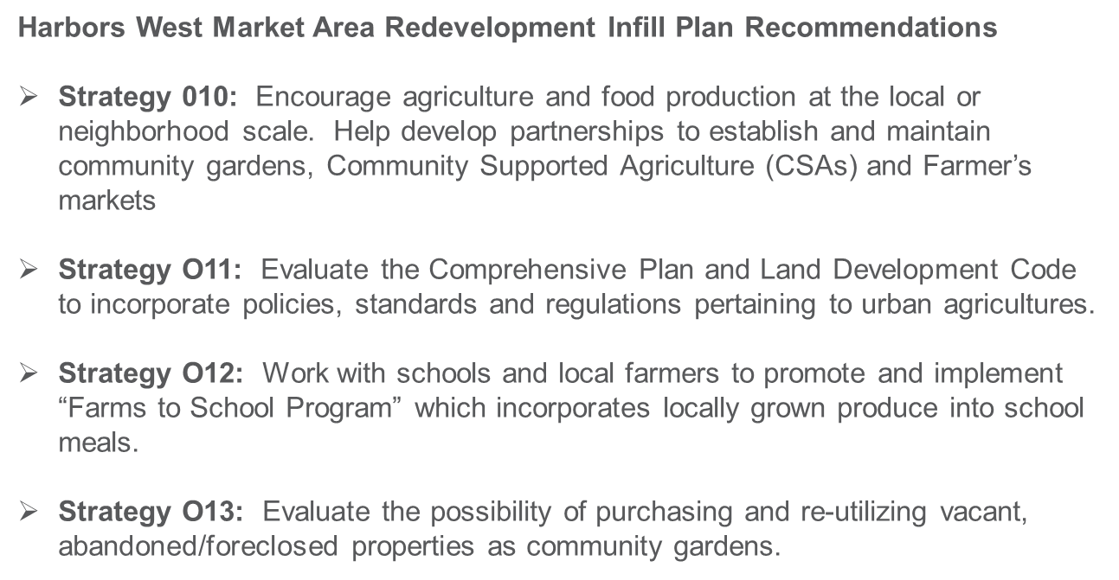
FOOD POLICY ADVISORY COUNCIL
Community Need Identification
The Harbors Plan Adopted June 2013 - 153 Implementation Strategies
Notes:
The Harbors West Market Area Redevelopment Infill Plan adopted by the Board of County Commissioners on June 25, 2013 identified a number of food policy strategies.

Slide 4
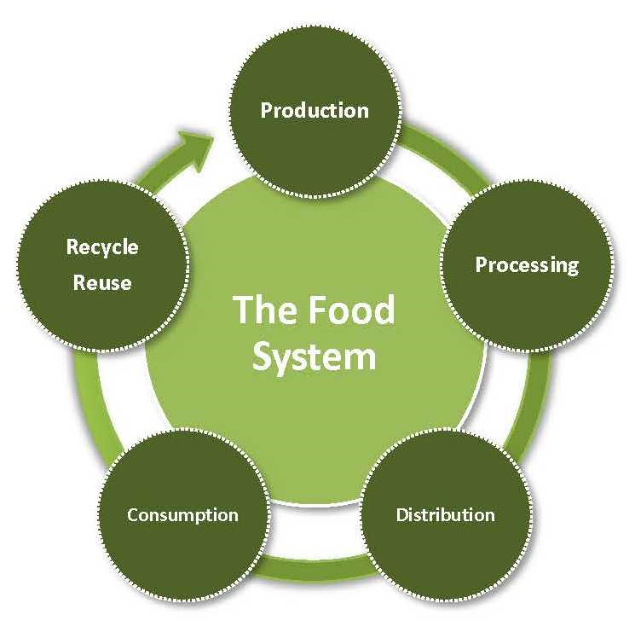
FOOD POLICY ADVISORY COUNCIL
VISION: An equitable, resilient, local food system in Pasco County
MISSION: The Food Policy Advisory Council facilitates the development of responsible policies improving access to culturally appropriate, nutritionally sound and affordable food produced in Pasco County.
Notes:
FPAC Vision is to provide an equitable, resilient, local food system. Mission is to develop responsible policies to improve access.

Slide 5
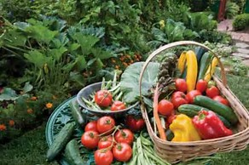
FOOD POLICY ADVISORY COUNCIL
The Food Policy Advisory Council focuses on:
  Connecting economic development, food security efforts, preservation and enhancement of agriculture, and environmental concerns;
  Supporting the development and expansion of locally produced foods;
  Reviewing proposed legislation and regulations that affect the food system;
  Make recommendations to government bodies; and
  Gathering, synthesizing, and sharing information on Community food systems
Notes:
FPAC initiatives focus in five primary areas.

Slide 6
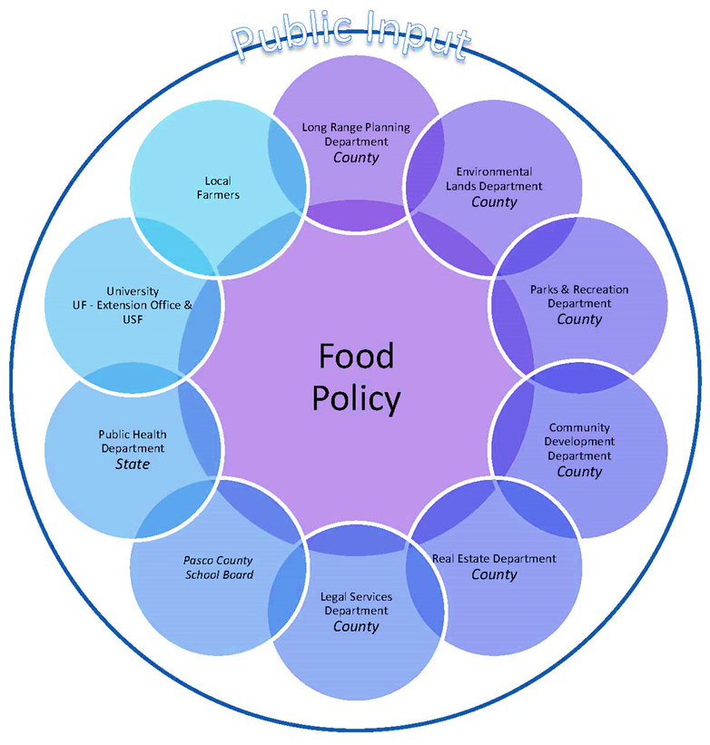
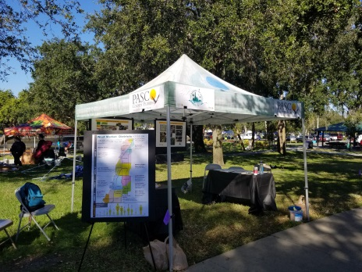

FPAC CITIZEN ENGAGEMENT
Website http://www.pascocountyfl.net/2304/Food-Policy-Advisory-Council
Public Comment Period at all Quarterly Meetings
Public Workshops as needed
Interested Parties email blasts (meeting agendas, topics of interest)
Festivals – booths
One-on-One Communications
Future CIVICLERK Agenda Posting
Notes:
FPAC utilizes a variety of public engagement techniques.

Slide 7
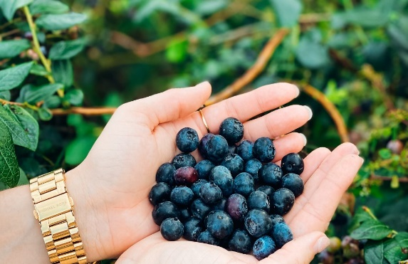
FPAC INITIATIVES
Monitor Florida Legislature Bills impact on Pasco ordinance (Example: Senate Bill 82 – Vegetable Gardening – Monitors
Land Development Code Revision Recommendations
  Chapter 406.8 Garden Plan Permits
  Chapter 530.23 Community Gardens, Market Gardens, Community Farms
Pasco County Community Food Assessment Update
  Robert Woods Johnson Foundation grant proposal (not funded)
  Volunteer Resiliency Intern
    Farmer’s Markey Survey
    Farmer’s Market Contact List
    Grocer’s Contact List
    Coordination with Tampa Bay Network
    to End Hunger - Hunger Gap Map
Blueberries
This Photo by Unknown Author is licensed under CC BY-SA
Notes:
FPAC initiatives are multi-fold. A Community Food Assessment Study was conducted in 2016.

Slide 8
FPAC INITIATIVES – Community Food System Assessment
Spearheaded by Pasco County Health Department, with assistance of Pasco Planning & Development Department, Long Range Planning Division
FPAC review & adoption
Resiliency Intern – Updated data for some sections
Notes:
The Community Food System Assessment was lead by the county health Department with county planners conducting a policy/regulation review.

Slide 9
FPAC INITIATIVES - Urban Agricultural Ordinance
Notes:
Next major initiative was development of an Urban Agricultural Ordinance.

Slide 10
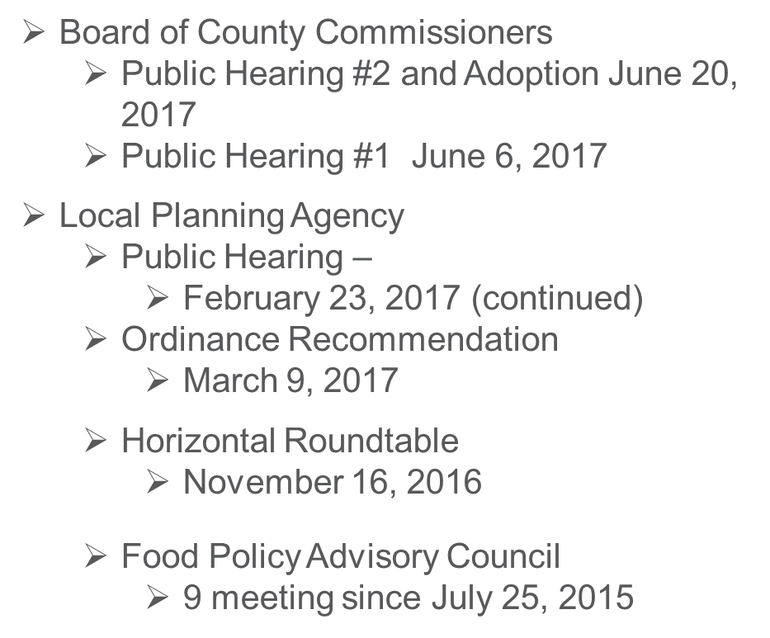
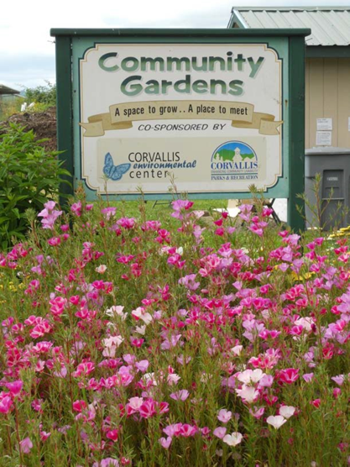
FPAC INITIATIVES – Urban Agricultural Ordinance
Notes:
Development of the ordinance was a two year process with significant public input and review.

Slide 11
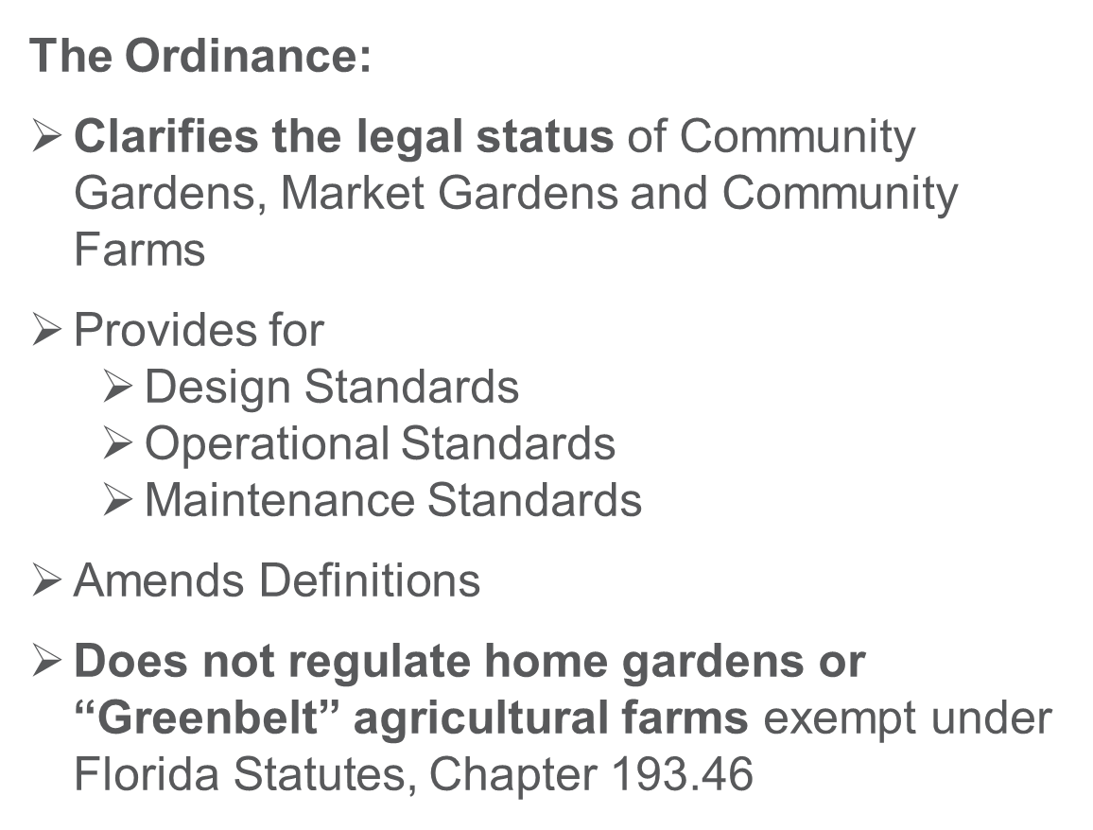
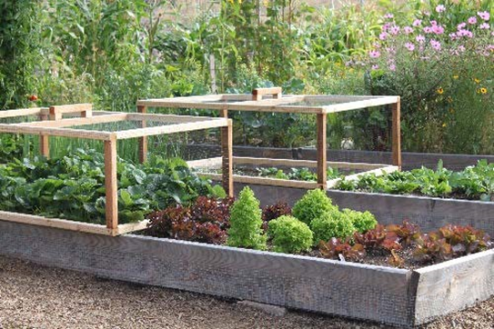
FPAC INITIATIVES – Urban Agricultural Ordinance
Notes:
The ordinance clarifies the legal status; provides for design, operational, maintenance standards, provides definitions and does not regulate home gardens or greengelt agricultural farms

Slide 12
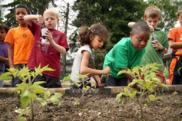
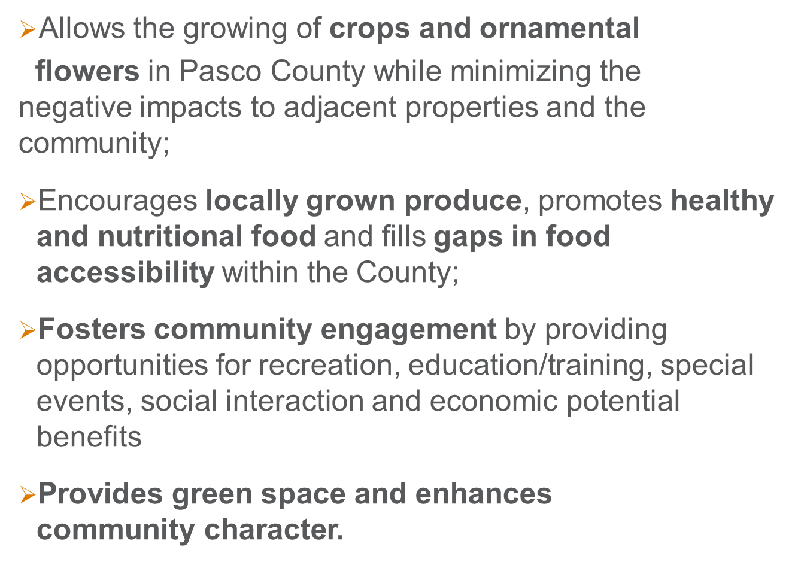
FPAC INITIATIVES – Urban Agricultural Ordinance
Notes:
The ordinance clarifies the legal status; provides for design, operational, maintenance standards, provides definitions and does not regulate home gardens or greengelt agricultural farms

Slide 13
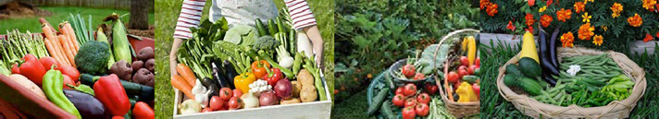
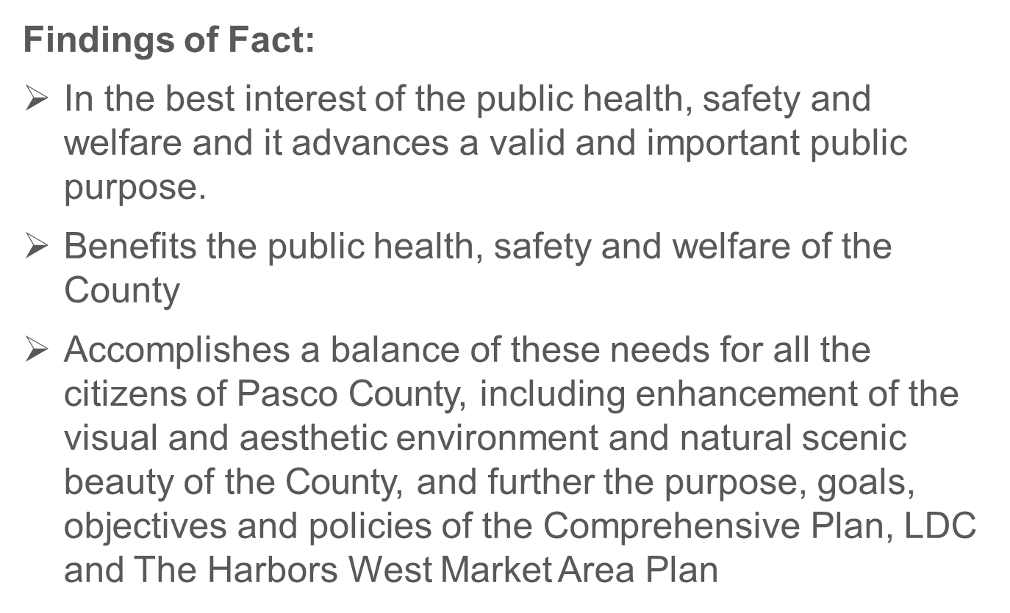
FPAC INITIATIVES – Urban Agricultural Ordinance
Notes:
The Findings of Fact to support the ordinance were multi-fold. Primarily in the best interest of the public health…..

Slide 14
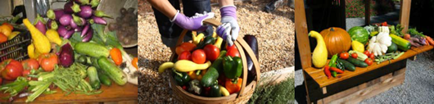
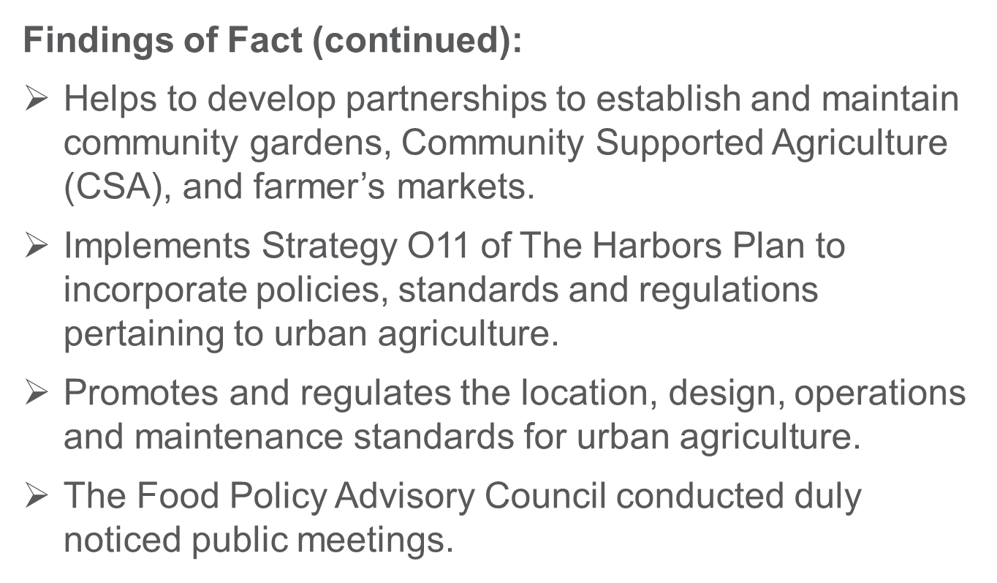
FPAC INITIATIVES – Urban Agricultural Ordinance
Notes:
The ordinance also helps to support partnerships, and implements Strategy O11 of the Harbors Plan.

Slide 15
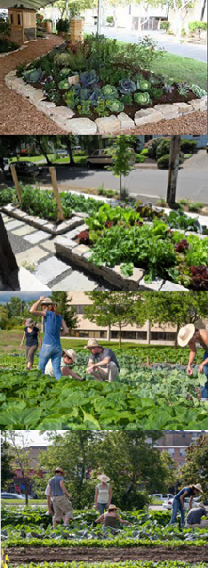
FPAC INITIATIVES – Urban Agricultural Ordinance
Garden Plan Permit
  Application Form (Gardens with Structures)
  Exemptions:
    Greenbelt farms – Exempt under Florida Statutes, Chapter 193.461(3)
    Home Gardens (> 14 vehicle trips per day generated by garden)
  Type of Garden
    Community Garden
    Market Garden
    Community Farm
Notes:
The ordinance requires “Garden Plan Permits” for gardens with structures.

Slide 16
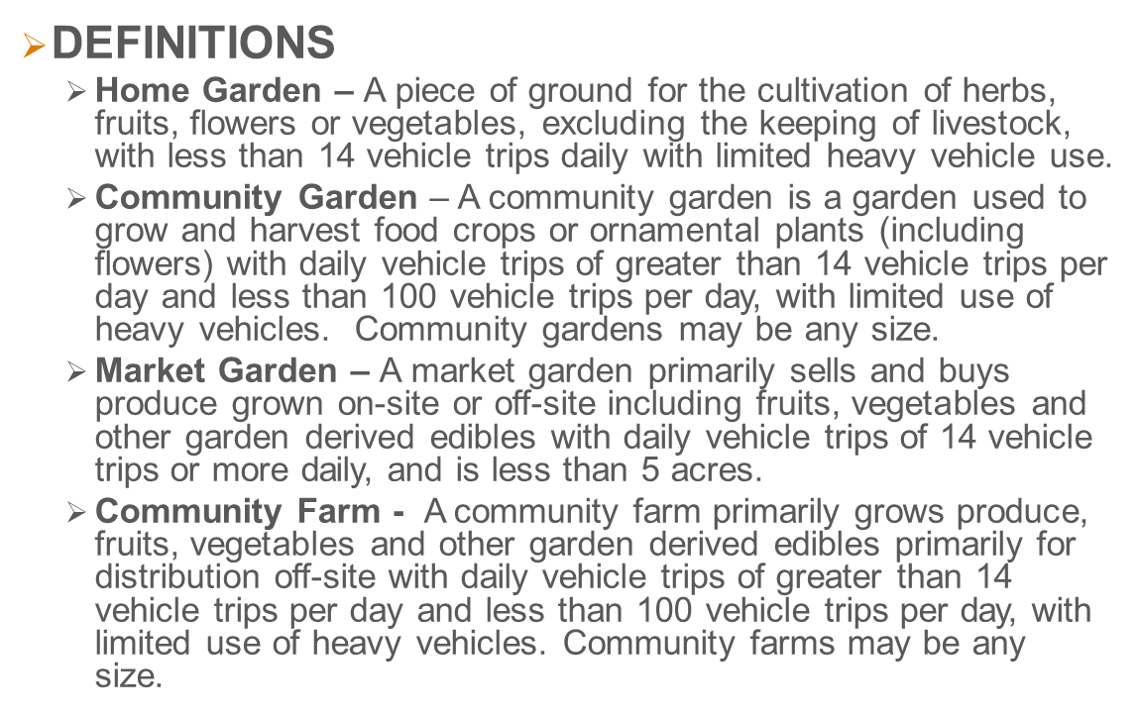
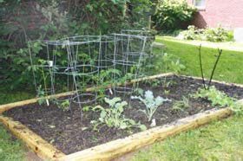
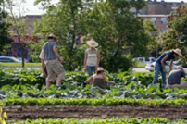
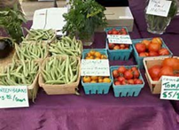
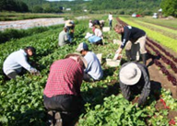
FPAC INITIATIVES – Urban Agricultural Ordinance
Notes:
The ordinance provides for definitions of home gardens, community gardens, market gardens and community farms.

Slide 17
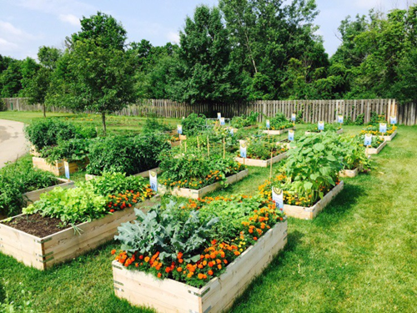
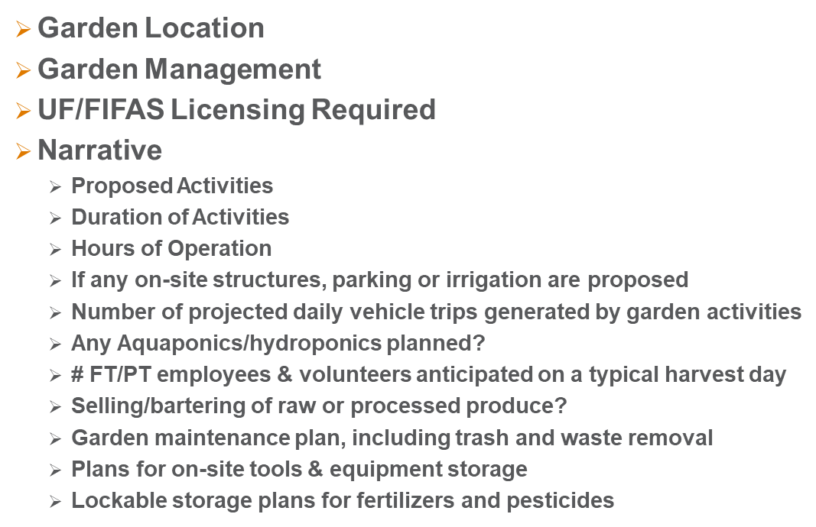
FPAC INITIATIVES – Urban Agricultural Ordinance
Notes:
The Garden Plan Permit Application includes a variety of information, including garden location, who will manage the garden/contact information, does the garden manager have UF/IFAS liscencing, as well as a narrative statement about the garden plans.

Slide 18
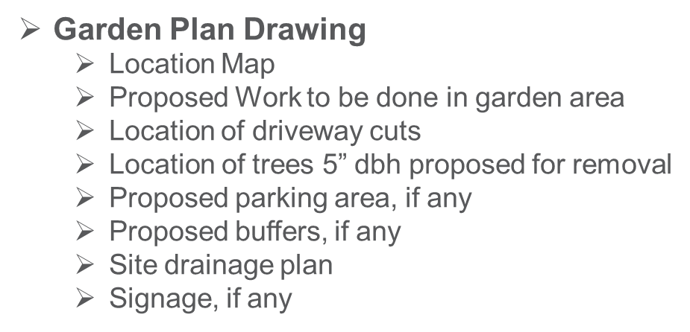
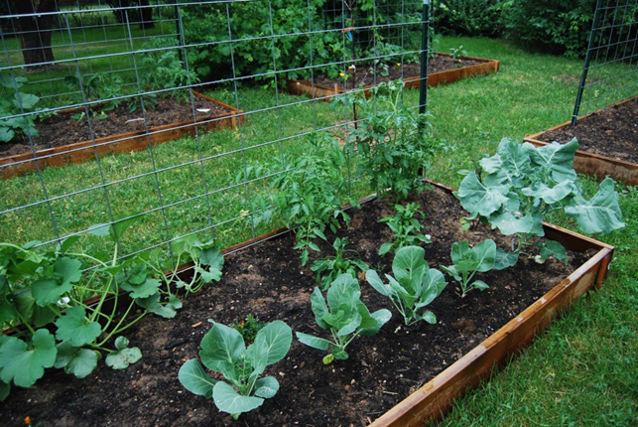
FPAC INITIATIVES – Urban Agricultural Ordinance
Notes:
For Gardens with structures, a dimensioned garden plan drawing is requested.

Slide 19
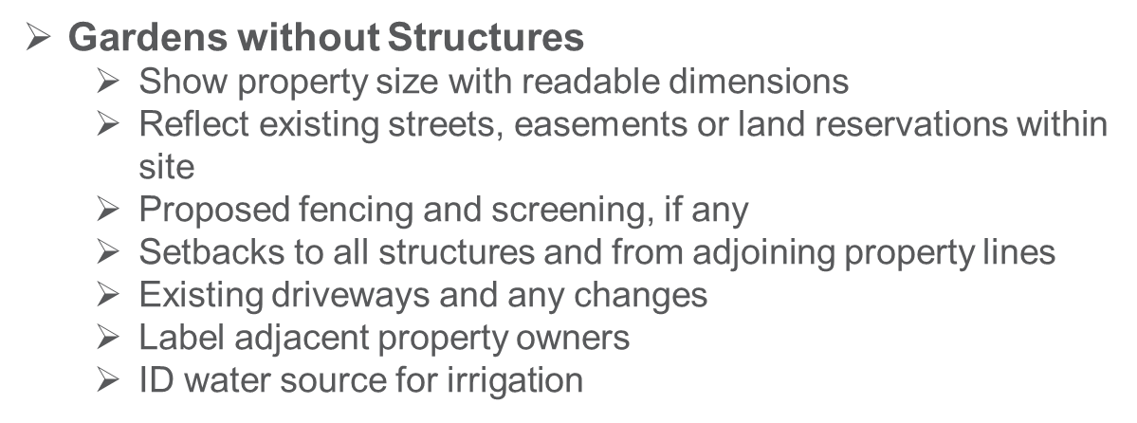
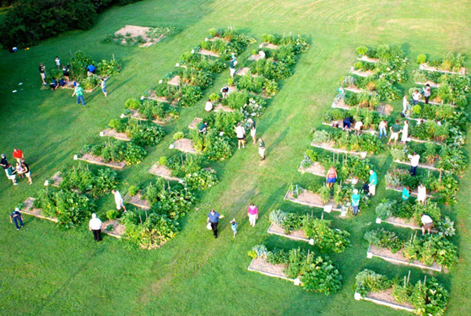
FPAC INITIATIVES – Urban Agricultural Ordinance
VOLUNTARY
Notes:
For Gardens without structures, applicants may voluntarily provide a garden plan.

Slide 20
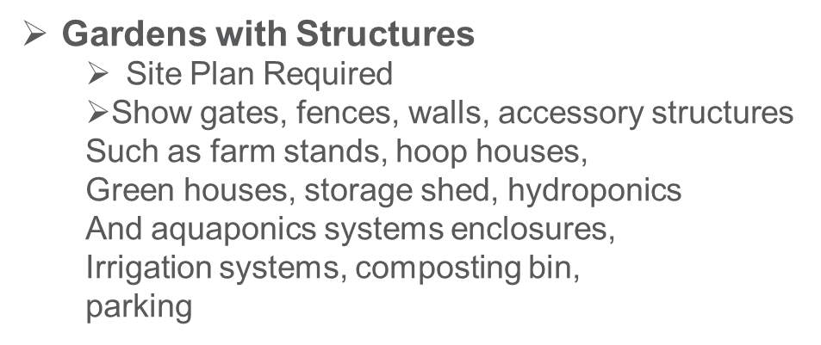



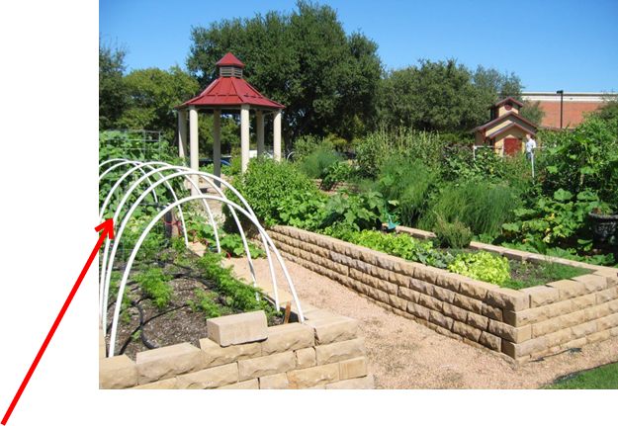

FPAC INITIATIVES – Urban Agricultural Ordinance
Notes:
For Gardens with structures it’s important to know what constitutes a structure. Hoop houses and raised bed walls do not. A gazebo or permamently affixed structure does. A Rubbermaid tool shed that is movable is not a structure.

Slide 21
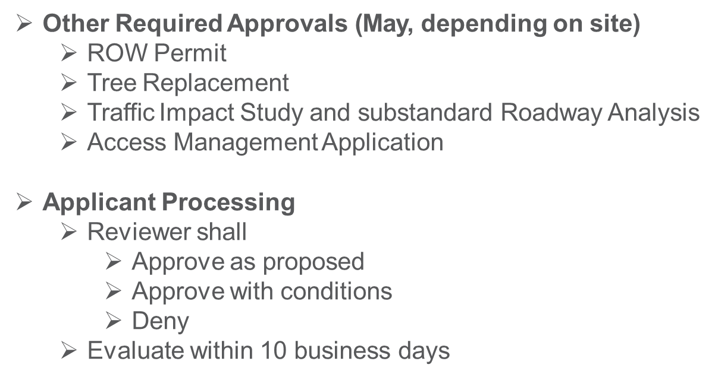
FPAC INITIATIVES – Urban Agricultural Ordinance
Notes:
Depending on the parcel and proposed site improvements, other applications and/or studies may be required. Garden Plan Permit reviewers are in our Current Planning Division and have 10 days to review upon receipt of a full application packet.

Slide 22
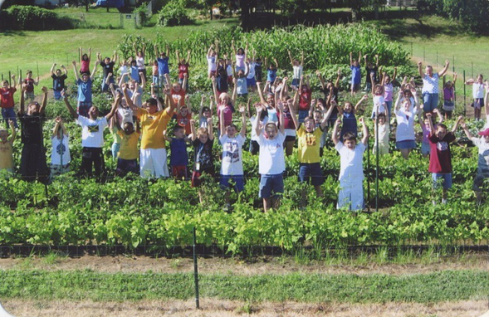
FPAC INITIATIVES – Urban Agricultural Ordinance
DEVELOPMENT STANDARDS
  Community Gardens/Market Gardens/Community Farms allowed as PERMITTED PRINCIPAL USES in all Agricultural zoning districts
  Table 530.23-1 LDC
    Permitted Use Districts
    Conditional Use Districts
Notes:
The ordinance defines Development standards, including where GCs, MGs, and CFs are permitted as principal uses, or require a conditional use.

Slide 23
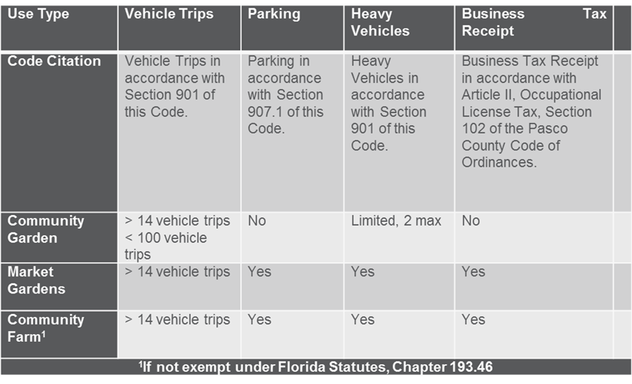
FPAC INITIATIVES – Urban Agricultural Ordinance
DEVELOPMENT STANDARDS
  General Standards – Primary Use; Accessory Use; Educational/Charitable Uses; State/Federal Regulations must be met, Heavy Vehicles cannot exceed 10% of all vehicle trips
  Design Standards – Garden Plan Permit Required; Buffers Requirement; Accessory Structure Maximum ground coverage; Irrigation Hook-ups/Water Conservation; Gates/Fences/Walls; ADA materials allowed; no Chain Link Fence
  Operational Standards – Produce sales; Noise; Special Events; Employees; Raw/Processed Food Sales; Farm Manager; Food Safety Certification from UF/IFAS annually; Aquaponics/Hydroponics/ No noise Sunset to Sunrise
  Maintenance Standards – Off Season Aesthetics/Weed Control; Locked Storage for Equipment, Fertilizers, Pesticides; Proper Compost Handling to Reduce Odors; Weekly Trash/Waste Removal
  Thresholds by Use
Notes:
The ordinance details general standards, design standards, operational standards and maintenance standards. Thresholds by use type define how many vehicle trips are allowable, as well as heavy vehicle trips, parking and whether a business tax receipt is required for each type of garden.

Slide 24
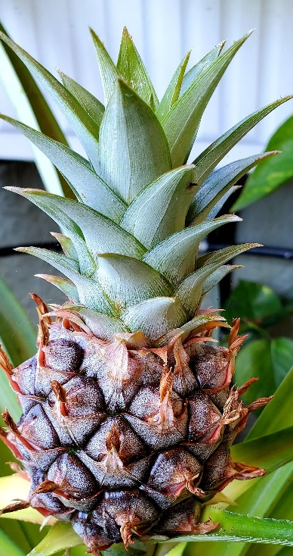
FPAC INITIATIVES – Urban Agricultural Ordinance
Community Gardens on Public Land
  Requires a Land Use Agreement
  On lands funded by impact fees – interim use only
  Community Farms allowed through ground lease agreements
  5’ direct access path required adjacent to public infrastructure
    Hardscape damage waiver must be filed with PC Utilities Engineering and Contracts Management Department.
  Garden must be registered on FPAC Urban Agricultural Registration website
  Garden Permit Application required
Notes:
The ordinance also specifies requirements for community gardens on pblic lands. Also, all gardens regulated by Section 530.23 of the LDC are required to be registered on the FPAC website. This assists with updates to the Community Food System Assessment study.

Slide 25
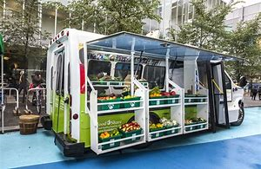
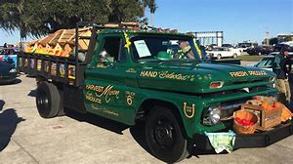
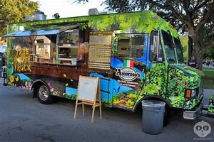
FPAC INITIATIVES – Mobile Vending Ordinance
Adopted 2018
Addresses Mobile Food Operations on Public and Private Property
  Food Trucks
    Food Truck Courts
  Veggie Vans or Produce Trucks
Mobile Food Operations are prohibited on public ROWs
Notes:
Other initiatives include: A mobile vending ordinance was adopted in 2018.

Slide 26
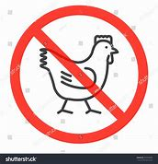
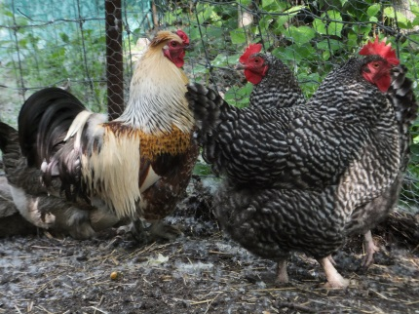

FPAC INITIATIVES – Backyard Chickens
FPAC researched and discussed 2017.
No consensus. CDC Alerts.
A member of the public requested ordinance in Summer 2018
Citizen Advocate presentation to FPAC in September 2018
FPAC referred to County Attorney’s office for possible “pilot program”, based on Seminole County model
County Attorney office determined “low tier priority”
BCC to re-evaluate Tier priorities
Notes:
Backyard chickens were heavily discussed, but FPAC could not achieve any consensus. These are handled ona nuisance basis by our code enforcement Department.

Slide 27
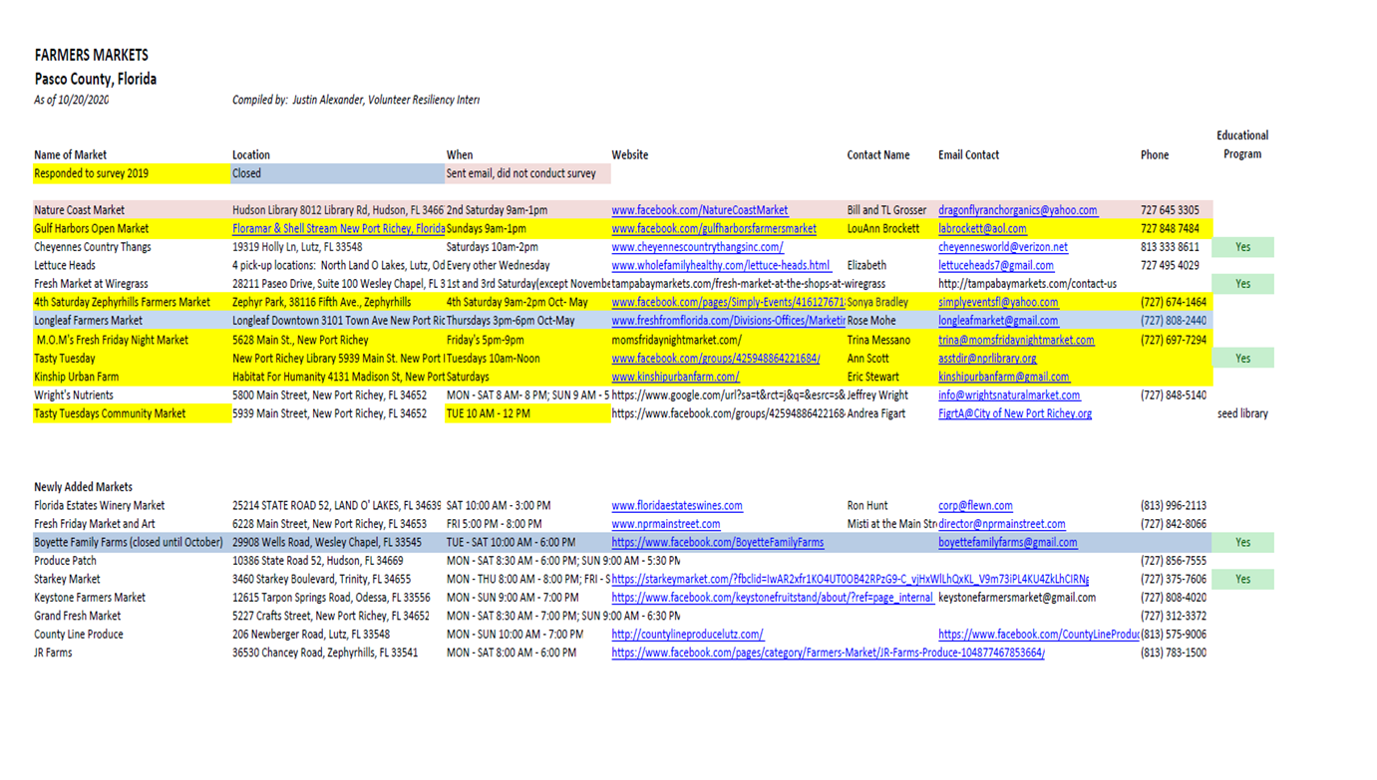
FPAC Initiatives - Farmer’s Market Survey – April 2021
Farmer’s Market Survey and List
Notes:
PDD19-0102 P2 Slide 12 of 13 Mary Duke

Slide 28
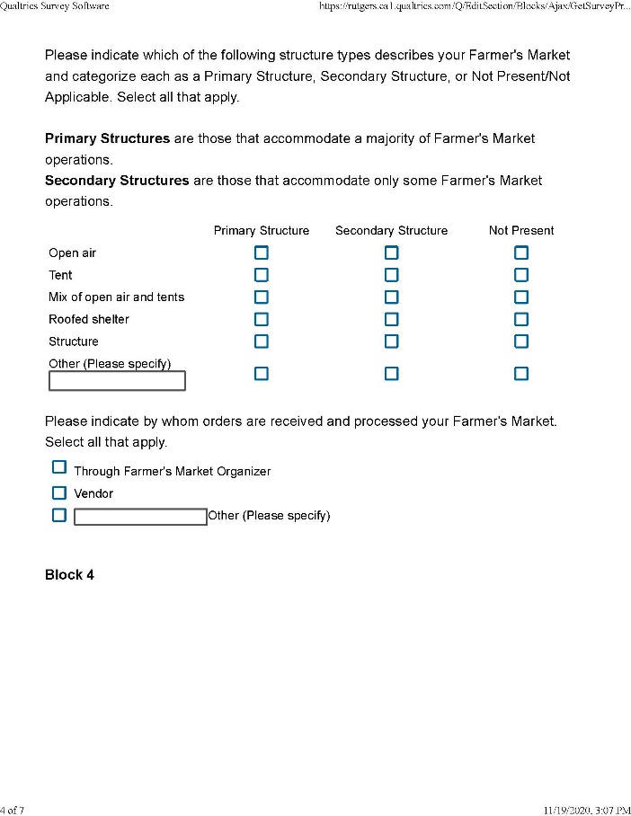
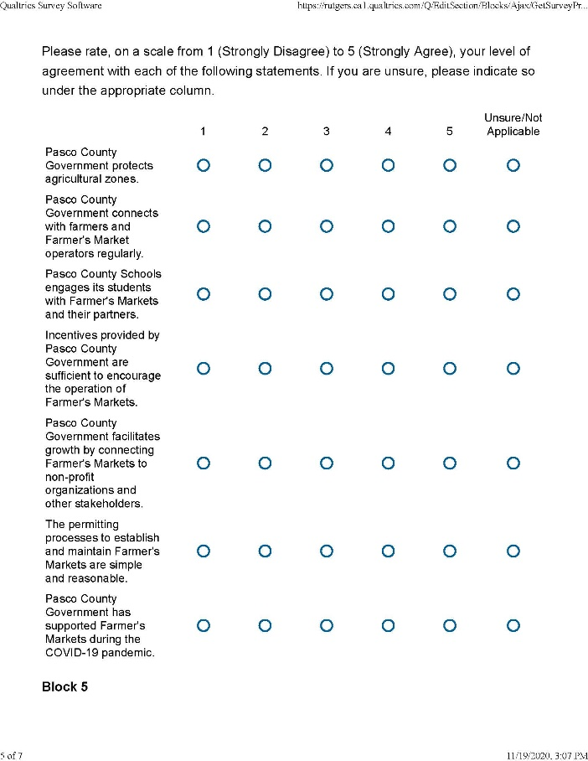
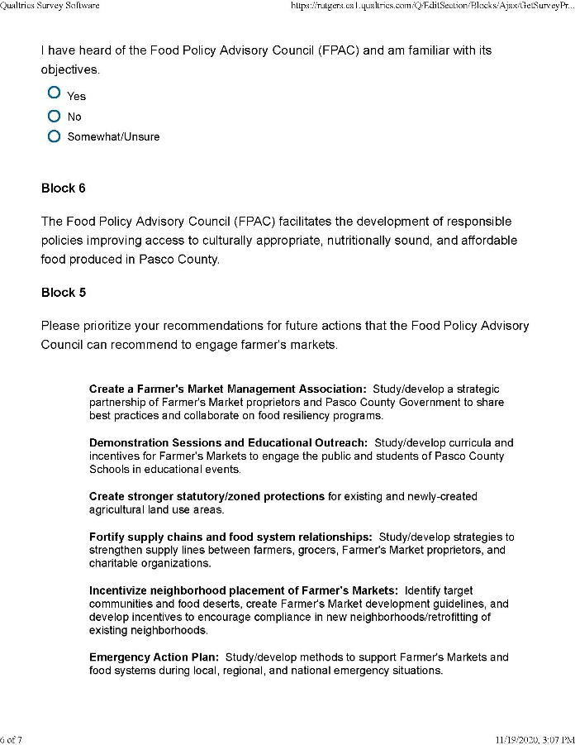
FPAC INITIATIVES- 2021 Farmer’s Market Survey Sample Questions
Notes:
A Farmer’s Market survey was developed and issued electronically. No responses. FPAC is now working to conduct emailed surveys and in person surveys.

Slide 29
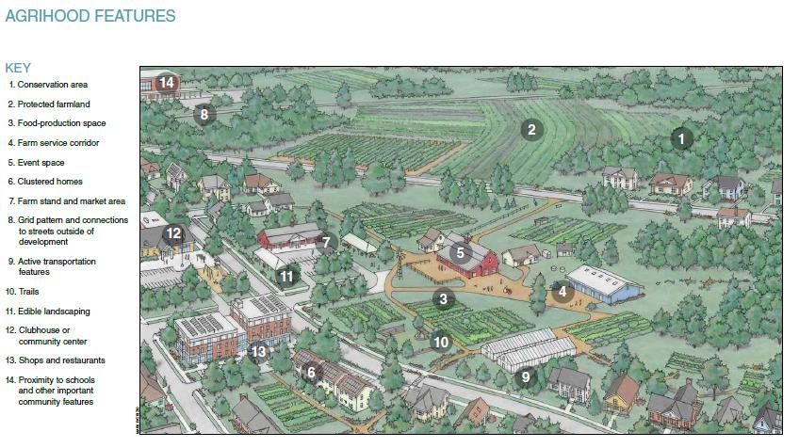
FPAC INITIATIVES – FPAC STRATEGIC PLAN
FPAC Strategic Plan
Three Strategic Plan Workshops Conducted
  4/27/2019 (SWOT Analysis)
  2/28/2020 (Goal 1 Development)
  8/14/2020 (Goal 2 Best Management Practices
  Overview)
GOALS
  GOAL 1: Increase Local Food System and Awareness Education to Encourage Local Food Production
  GOAL 2: Create an Ordinance to Develop Incentives for Gardening and Agrihoods
    FPAC Survey (Internal) – BMPs/Incentives Priorities (ongoing)
  GOAL 3: Create a Local Food HUB and Distribution Chain
    Coordinate efforts with PEDC Food HUB Committee
This Photo by Unknown Author is licensed under CC BY-SA
Notes:
FPAC is working to develop an FPAC Strategic Plan to develop a 5 year work program to focus efforts.

Slide 30
FPAC INITIATIVES - STRATEGIC PLAN - GOALS
GOAL 1: Create a local food system department within county government.
MISSION
      Enhance awareness and build a resilient community through the collaborative creation and growth of a local food system designed to preserve resources, educate citizens and create equitable access to healthy, local, sustainable food which fosters a premier quality of life in urban, suburban and rural spaces.

Slide 31
STRATEGIC PLAN – GOAL 2 - Create an Ordinance to Develop Incentives for Gardening and Agrihoods - Rural Protection Areas
Pasco County 2025 Comprehensive Plan - Future Land Use Element
Goal FLU 2: PROTECTION OF RURAL AREAS
Implement and enforce policies and programs designed to preserve and reinforce the positive qualities of the rural lifestyle and protect rural communities and agricultural areas.
Objective FLU 2.1: Preserve Rural Lifestyles in the Northeast Pasco County Rural Area
Policy FLU 2.1.1: Recognition of the Northeast Pasco County Rural Area
Policy FLU 2.1.2 Recognition of the Rural Transition Area
Policy FLU 2.1.3 Recognition of the Planning Framework
Policy FLU 2.1.4 Development of a Long Term Planning Vision
o o o o o to Policy FLU 2.1.18
Objective FLU 2.2 Maintain the Economic Viability of Agricultural Production and Uses
Policy FLU 2.2.1 Agricultural Primacy
Policy FLU 2.2.2 Agricultural/Rural Land Use Open-Space Requirement >20 DU must preserve 50% acreage as open space
Policy FLU 2.2.3 Agricultural/Rural Land Use MPUD Master Planned Unit Development Clustering Requirement
Notes:
The 2025 Pasco County Comprehensive Plan has Rural Protection Areas. Agrihood provisions in the Comp Plan and LDC are being evaluated to increase incentives.

Slide 32
STRATEGIC PLAN – GOAL 2 - Create an Ordinance to Develop Incentives for Gardening and Agrihoods -
Pasco County 2020 Comprehensive Plan Map 2-2 Rural Protection Areas
Notes:
These areas will be the focus of Agrihood discussions.

Slide 33
FPAC INITIATIVE – TBRPC RESILIENT REGIONAL ACTION PLAN RESOLUTION FPAC 21-02
FPAC ADVOCACY – REQUEST BCC SUPPORT
Tampa Bay Regional Planning Council Resilient Regional Action Plan (RRAP)
  FPAC RRAP Food Security Statement
    A lack of attentiveness to food security as a serious regional concern.
    Food policy strategies were not listed as a high enough priority on the RRAP’s action items.
    The RRAP should take into consideration the likelihood of future natural disasters and pandemics that can cause massive disruption to food systems.
    Too low of a level of significance for explicit food system security needs. A much higher emphasis is needed regionally.
  Local food production needs to be preserved and encouraged, especially in urban areas of the region.
This Photo by Unknown Author is licensed under CC BY-SA
Notes:
FPAC provided detailed feedback into development of a TBRPC Resilient Regional Action Plan Goals, Objectives and Action Items to support food systems in the Tampa Bay Region.

Slide 34
FOOD POLICY ADVISORY COUNCIL
FPAC ADVOCACY
  FPAC RRAP Food Security Statement (continued)
    Increase involvement of food system stakeholders in the development of RRAP Plan priorities is needed.
    RRAP needs to elevate food system security, resiliency, and food access to a higher level of prioritization;
    Lack of acknowledgement that food affordability and inaccessibility are still prescient issues in Pasco County and other Tampa Bay communities.
    Food policy advocates within the Tampa Bay region should be invited to TBRPC Resiliency Coalition meetings, sub-committee meetings and trainings to ensure food security matters are addressed in the RRAP. Existing Food Policy Advisory Councils should be invited to send a council member representative to future trainings, summits, coalition meetings, committee and sub-committee meetings.
This Photo by Unknown Author is licensed under CC BY-SA
Notes:
PDD21-0084 N121-0259 Slide 10 of 14 Mary Duke

Slide 35

FPAC INITIATIVES – FPAC RESOLUTION 21-01 PLANT FOR PASCO
PLANT FOR PASCO INITIATIVE
Partnership with Tampa Bay Network to End Hunger “Waste No Food Tampa Bay” Campaign
  COVID-19 response initiative
  In concept development/feasibility/research phase
  Focused marketing and social media campaign to Pasco County residents and business owners
  Link to Waste No Food APP
  Links surplus produce to local non-profit organizations for distribution to needy residents
  Encourages local food production via creation of new home gardens, neighborhood and community gardens
This Photo by Unknown Author is licensed under CC BY-SA
Notes:
In response to COVID, FPAC partnered with the Tampa Bay Network to End Hunger to help market their Waste No Food Tampa Bay initiative and APP in Pasco County. There are links from the FPAC website to this program. Program participation increased significantly after this effort.

Slide 36
FOOD POLICY ADVISORY COUNCIL
Staff Liaisons (Planning and Development Department)
  Mary Helen Duke, AICP,
  Principal Planner – Resiliency
  mduke@pascocountyfl.net
  Sonide Simon, Planner II
  ssimon@pascocountyfl.net
  Justin Alexander, Resiliency Intern
  jalexander@pascocountyfl.net
  Responsibilities:
FPAC Member Coordination
FPAC Meetings Coordination/Agendas/Meeting Minutes
FPAC Website
Research/Best Management Practices
Comprehensive Plan / Land Development Code / Regional Resiliency Action Plan coordination of Goals, Objectives, Action Items
FPAC Strategic Action Plan Facilitation and Pasco County Food Systems Assessment Study
Plant for Pasco Initiative Research/Planning
Grants Research/Submittals
  Robert Woods Johnson Foundation Global Initiatives (Summer 2020)
Trainings: 2020 Florida Food Summit
Notes:
There are 2 to 3 people in PDD that assist FPAC implement it’s vision.

Slide 37

FOOD POLICY ADVISORY COUNCIL
Member and Alternate Member Categories
Grocer/Food Distributor
Local Farmer
Health Care Professional/Health Department
Food/Nutrition Expert – School System
Non-Profit Organization Representative
Farmer’s Market Representative
Academic Professional University/Higher Education
Food Systems Attorney
Certified Nutritionist
At-Large #1
At-Large #2
UF/FAIS Agricultural Extension (ex-officio/non-voting)
Notes:
There are 2 to 3 people in PDD that assist FPAC implement it’s vision.

Slide 38
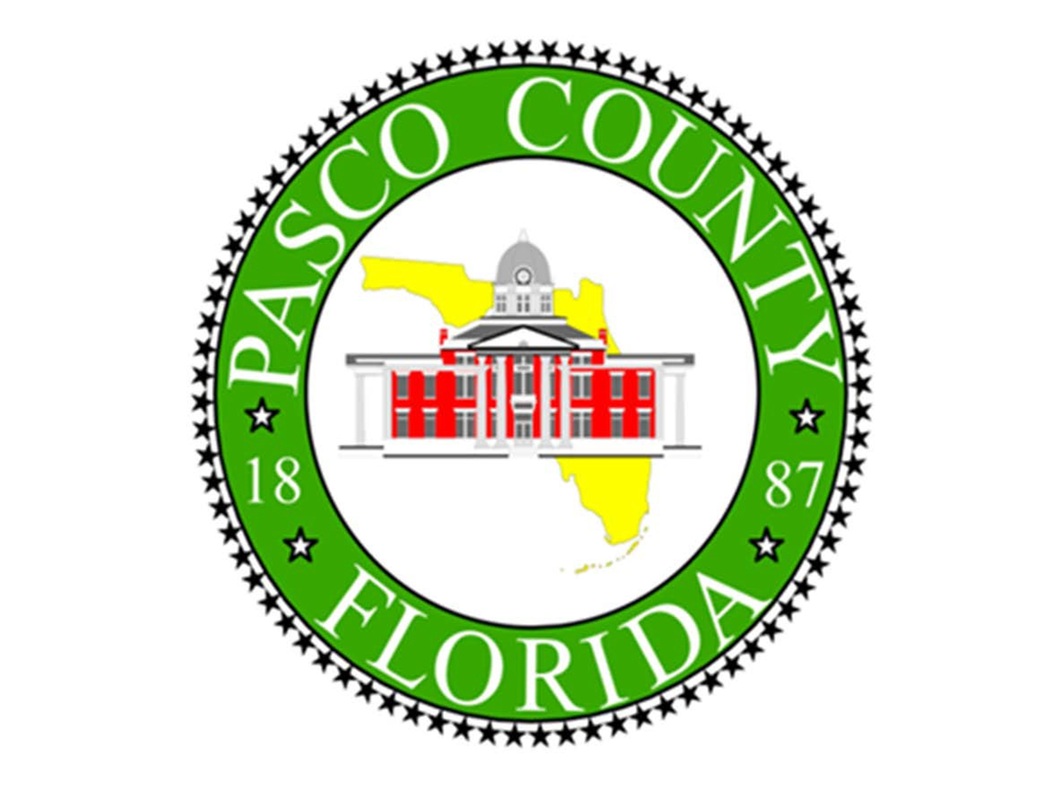
Notes:
Thank you!

